Slide 1
Transportation Problem
Transportation is LP Problem about transport and delivery. The best example for transportation is many tons of wheat no transport from area to area.

Slide 2
Methods of solving the Transportation Problem Initial Basic Feasible Solution (IBFS) methods
NW Corner
Least cost
Vogel (VAM)

Slide 3
Optimal Solution methods :
Stepping Stone
Modified method

Slide 4
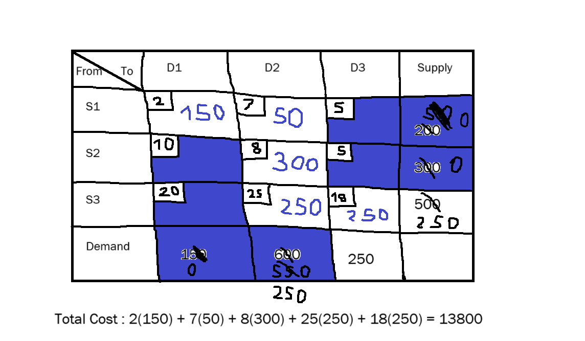
North West corner method
In NW we start in northwest corner and transfer to another cell to end of equation .

Slide 5
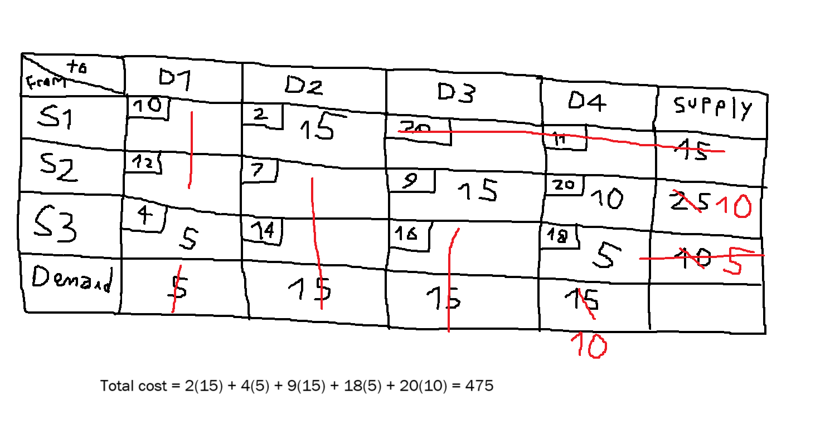
Least cost method
In least cost method we started in least cell with cost and then we go
To another least cost cell to end of equation.

